Slide 1

Persuasive Master Challenge
Diagnosis
Vesicle Isolation
Protein Analysis

Slide 2
CONTEXT

Slide 3
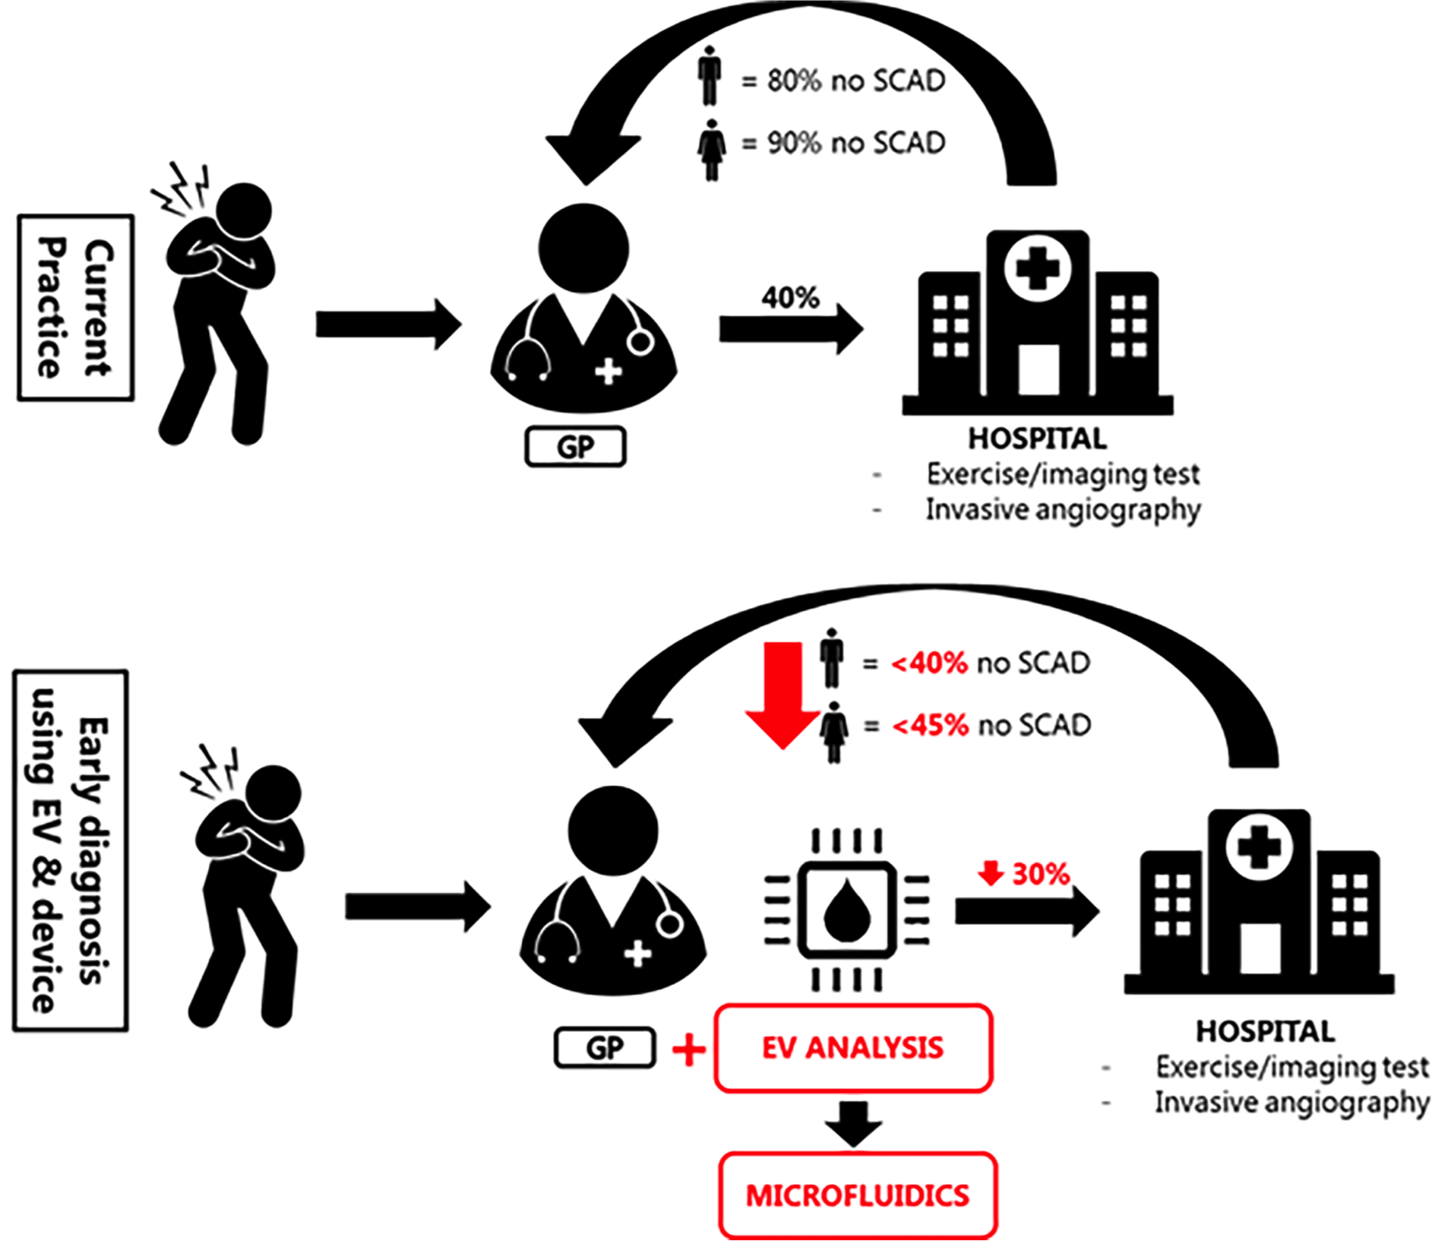






PERSUASIVE focuses on non-acute chest pain patients
CONTEXT
CHEST PAIN
non-acute (95%)
acute (5%)
possible underlying problems
acute cardiac problems
50%
20%
10%
5%
10%
5%
can identify cardiac cases in non-acute chest pain

Slide 4
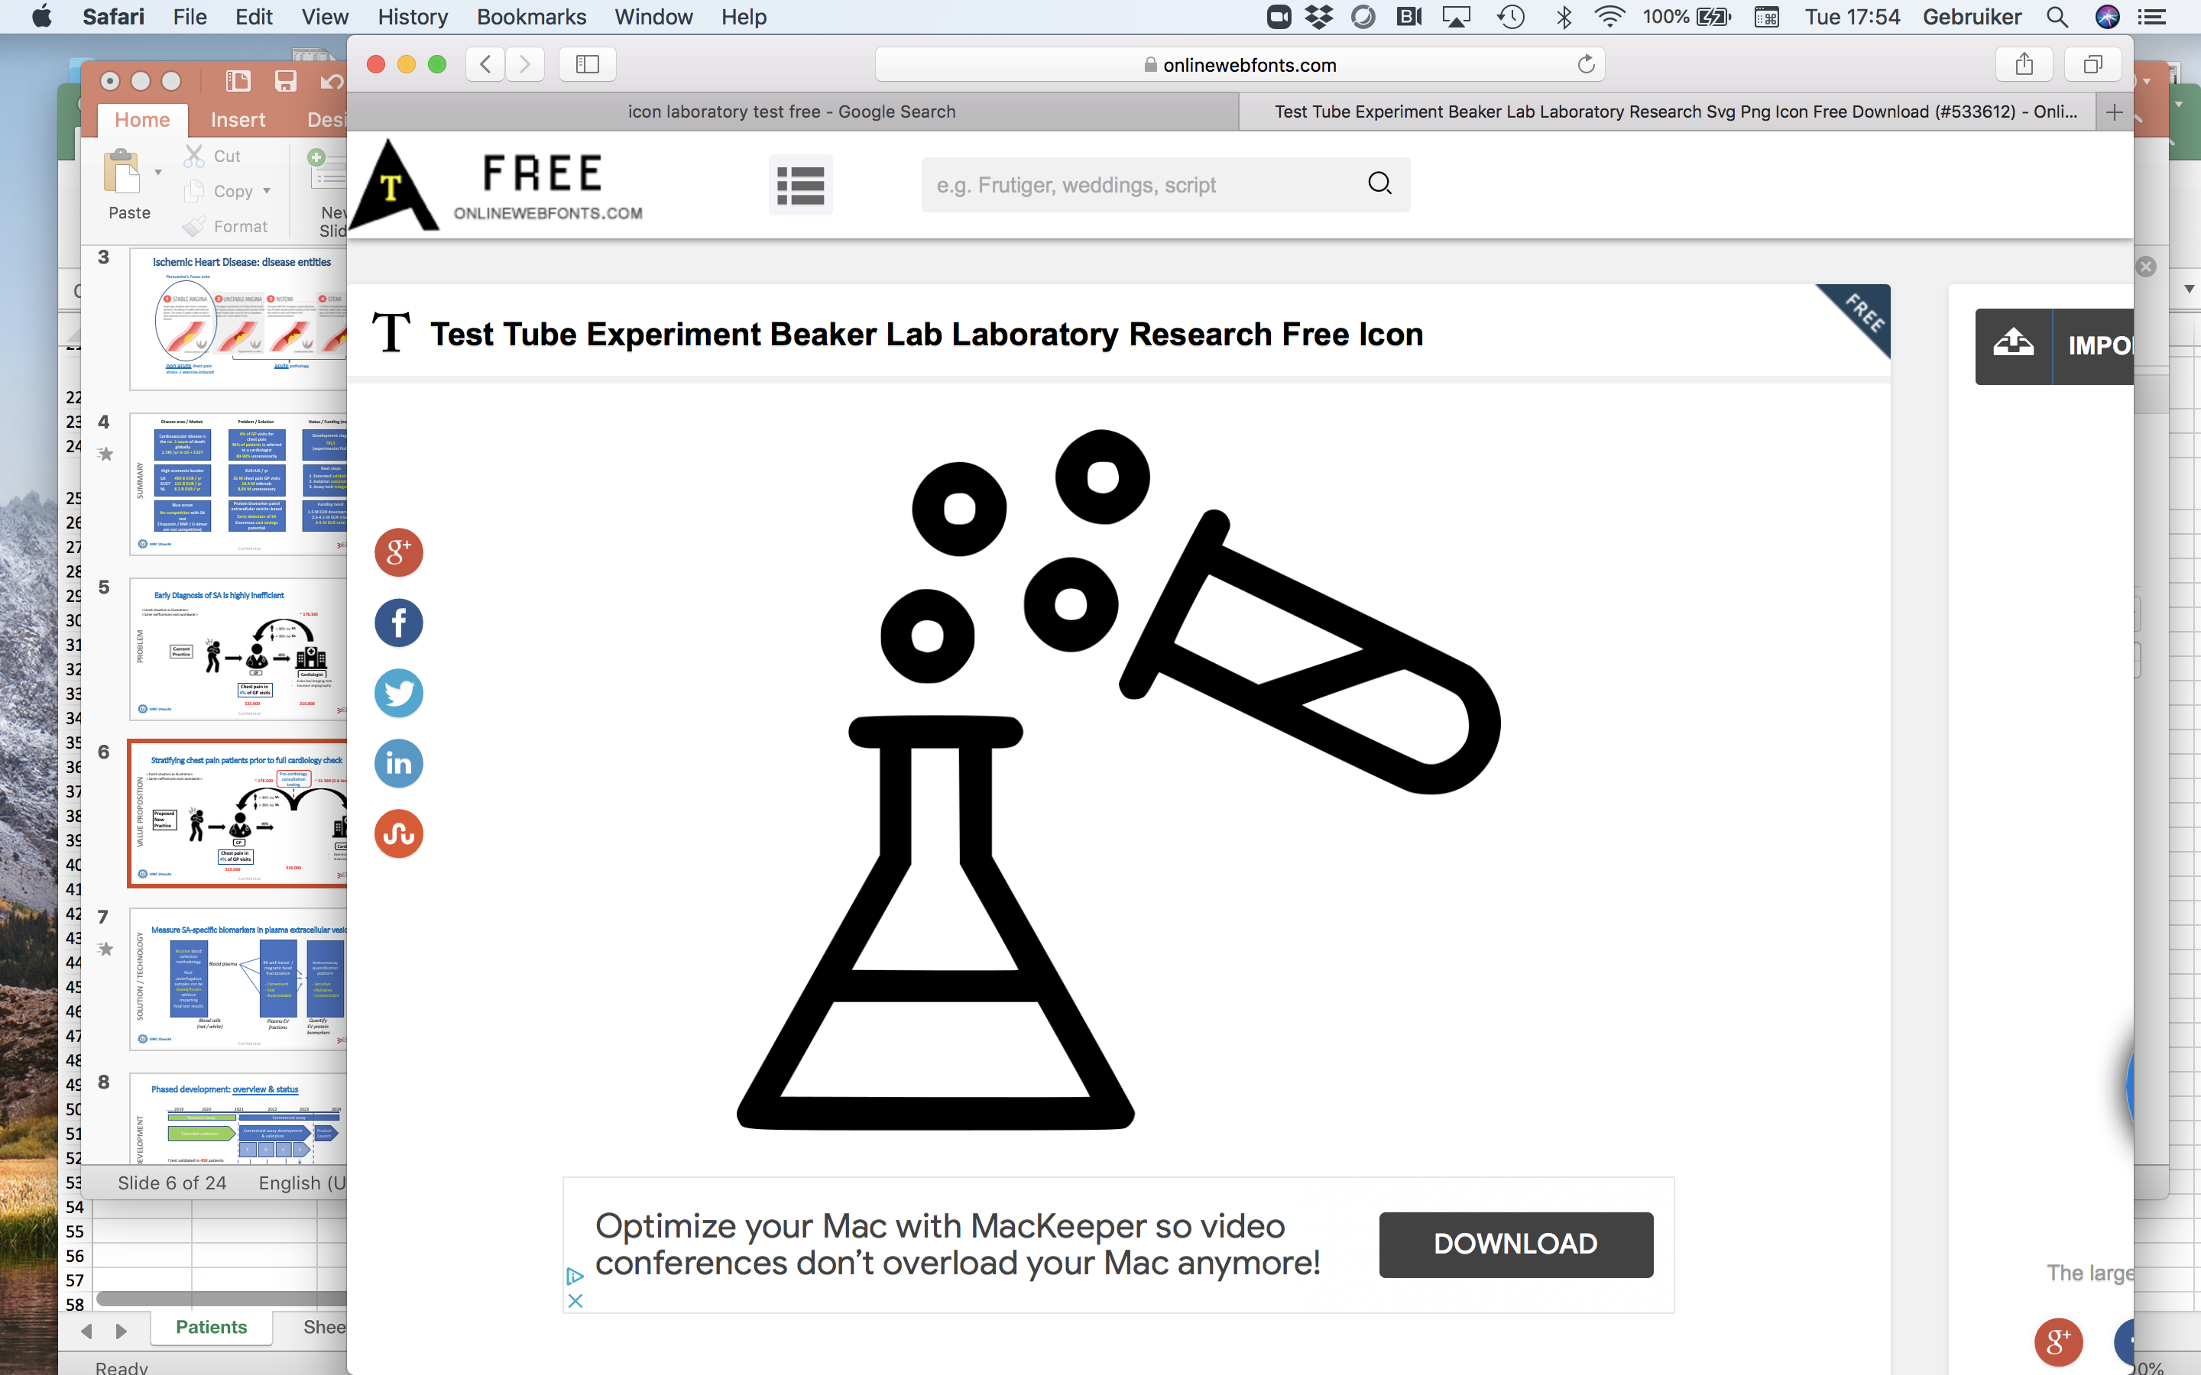
80% of chest pain referrals are unnecessary; opportunity for significant cost reduction
SOLUTION PROBLEM
Illustrated is the Dutch situation - similar inefficiencies exist worldwide
210.000 referred
525.000
100%
Problem
€1.400 / referred
patient **
GP
Hospital
80%
Significant cost reduction * / **
(€200 mln/yr)
210.000 referred
Solution
525.000
100%
20%
€460 / patient
GP
laboratory
Hospital
80%
* High cost savings are possible as estimated by Zorginstituut Nederland (2017), Zinnige Zorg verbetersignalement 'Pijn op de borst’.
** Confirmation in PERSUASIVE’s health-economic study (NL context) – see appendix, slide 18

Slide 5
New solution using proven technology
TECHNOLOGY
MVP = CE-marked modular system, to be realized in 2 years
System to be
CE-marked
Sample Processing
Quantification
Data Analysis
Laboratory Robot
(Hamilton)
Read-out Unit
(Protein Simple – Ella)
Dedicated Algorithm
Patient
sample
input
Patient
test result =
diagnosis
More detailed technology impression – see appendix, slide 15

Slide 6








User Story
USER STORY
1
2
3
4
Klinisch laborant ontvangt bloed van de huisarts
Laborant verwerkt het bloed met de Persuasive kit
Eiwit waardes worden bepaald met behulp van apparatuur
Deel-input voor de software zijn eiwit waardes
5
6
7
8
Laborant plaats resultaten in het Laboratory Information Management System
Lab resultaten worden overgebracht naar het patiënten dossier
Huisarts haalt resultaten van eiwit waardes uit het patiënten dossier
Huisarts importeert eiwit waardes en voegt patiënten gegevens toe. Software berekend laag, gemiddeld of hoog risico voor Stabiele Angina

Slide 7
Input-Output
INPUT-OUTPUT
Patient number
Patient name?
Sex
Age
Signal value protein 1
Signal value protein 2
Signal value protein 3
Signal value protein 4
Signal value control > x
Patient number
Valid/non valid with error explanation
Low/medium/high risk of SA
INPUT
OUTPUT
ALGORITHM

Slide 8
SOFTWARE workflow example
ALGORITHM
Check fields for value
Check if control value > x
Check protein signals > x
Calculate risk score
Classify risk score
Risk score variables:
Sex
Age
Signal value protein 1
Signal value protein 2
Signal value protein 3
Signal value protein 4
Error
Error
Error

Slide 9
ALGORITHM Requirements
ALGORITHM
All input fields must be filled in, otherwise message that fields are open
Control sample must be above cut off value (to be determined), otherwise message ''recommend to repeat test (possibly contamination)''
Protein Signal values must be above value x (to be determined), otherwise message ''recommend to repeat test (possibly not enough target input)''
Input values determine risk score via algorithm with weighting factors (see example in case study)
Outcome of algorithm above below a value (to be determined) means a low risk of Stabile Angina
Outcome of algorithm above between values (to be determined) means a medium risk of Stabile Angina
Outcome of algorithm above between values (to be determined) means a high risk of Stabile Angina

Slide 10
General requirements
REQUIREMENTS
User friendly (attractive/professional user interface) and recognizable for general practitioners
Software will be an In vitro Diagnostic Device (Class B) and must be compliant to ISO62304
Ensure that algorithm IP is protected
Patient data protected and meets GDPR
Input of signal value proteins must be importable (excel)
Input of other patient data separately added
Options platform: for example locked excel or cloud-based solution
Option to collect patient data at Persuasive for further research

Slide 11
Case study
Case Patiënt
Risk category | Risk-value
Low risk | <30
Medium risk | 30-40
High risk | >40
Patient data
Murad de Vries
23-03-1953
Male
Signal value protein 1 = 2
Signal value protein 2 = 4
Signal value protein 3 = 3
Signal value protein 4 = 3
Control value control = 2
Risk-calculation factors
Male factor = 0,5
Female factor = 0,75
Age factor = 0,5
Protein 1 factor = 2
Protein 2 = 0,5
Protein 3 = 1
Protein 4 = 0,5
Valid control value = 1-3
Minimal protein value = 0,2

Slide 12
Expectations
Case Patiënt
Working (functional) software prototype that can be used for demos by Persuasive
Use excel file as data input format, other formats may be considered
Create folder structure in which relevant background information found is stored for future use of Persuasive

Slide 13
Develop a (online) software platform for the Persuasive Diagnosis Tool 1) Market research comparable platforms/user requirements 2) Should the tool be cloud-based/local software/plug-in/phone app 3) What is the program code Persuasive can use? 4) What should the frontend look like? Good luck with the challenge!
CHALLANGE

